Slide 1
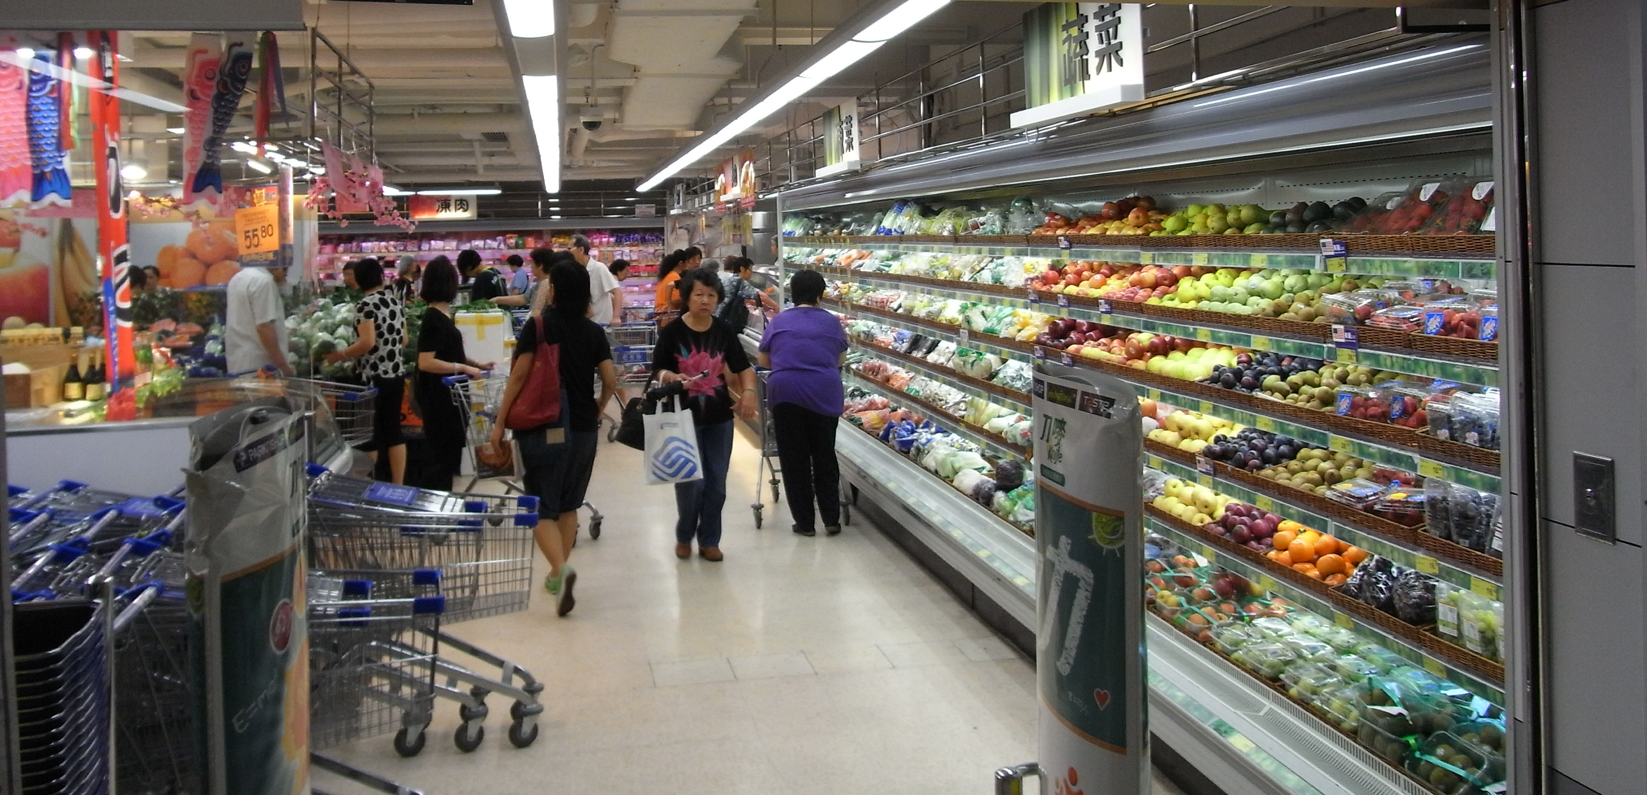
Superstore customer sales analysis
This Photo by Unknown Author is licensed under CC BY-SA

Slide 2

Content
Objective
Review of Data Source
Descriptive insights
Results
Interpretation
Future Recommendation
This Photo by Unknown Author is licensed under CC BY-SA-NC

Slide 3

Objective
Recurring customers and best-selling products are main aspects to drive any business.
Our objective of the project is to study insights to boost a company's overall revenue by understanding the consumers, how our sales trend goes, and how to utilize this trend research to develop better marketing strategies.
We will try to segment customer so that we can target them better based on their needs.
This Photo by Unknown Author is licensed under CC BY-SA-NC

Slide 4

Data Overview
This Photo by Unknown Author is licensed under CC BY-ND
Superstore Customer Sales Analysis
The Superstore is very large supermarket, often selling household goods, clothes, and electrical goods across United States.
Data Source: https://data.world/cmack624/superstore-20204
This dataset is from year 2017-2020.
Observations – 9994
Features – 21
Dataset consists of :
Order ID: Unique Order ID for each Customer.
Order Date: Order Date of the product.
Ship Mode: Shipping Mode specified by the Customer
Unique ID to identify each Customer.

Slide 5
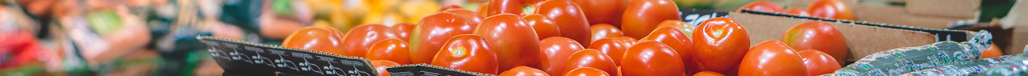
Segment: Three different segments of customers like Consumer, Corporate and Home Office
City: City of the residence of customer in United States
State: State of the residence of customer in United States
Postal Code: Zip Code of the area
Category- Category of the product ordered
Sub-category – Sub-Category of the product ordered
Product Name – Name of the product
Sales – Sales of the Product
Profit – Profit/Loss incurred

Slide 6

Descriptive Insights
After pre-processing the data, we applied descriptive analysis to the cleaned dataset from which we found where customer ID has no null values.
From checking the time frame of the dataset, we came to know that we have historical customer data for the period of 3 years.
Min and max is used to find out the exact order date and time of united states. The order data is from Jan 3, 2017, till Dec 12, 2020.
After pre-processing the data, we applied descriptive analysis on the cleaned dataset from which we found out of top 5 states most customers are from Florida based in US.
We observed that top five values of order id with order. Here we can observe that first order id has 14 different order while second has 12 order and so on.
Customers with recency ranges from 1500 to 2000 and frequency is ranging from 0 to 100, monetary ranges 1500 and above.

Slide 7
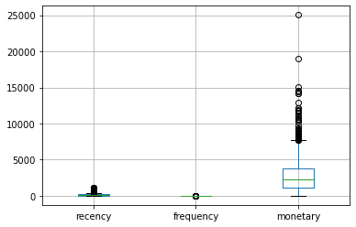
Outliers
We calculated Monetary, Frequency, and Recency values grouped by customer id and tried to plot these values in the box-plot, this data is suffered from outliers which might cause inaccurate predictions. So, we normalize data.

Slide 8
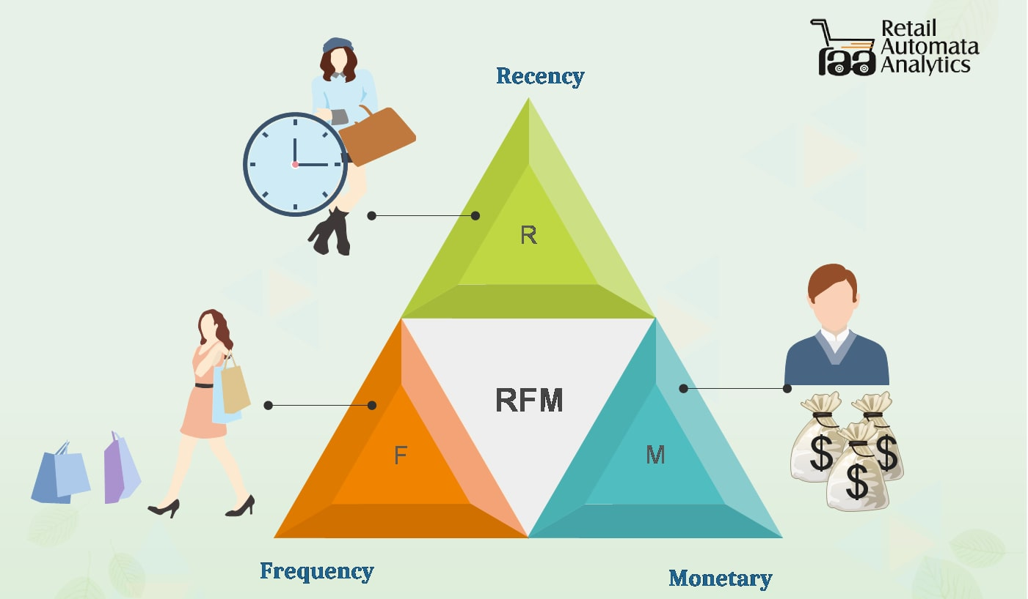

Slide 9
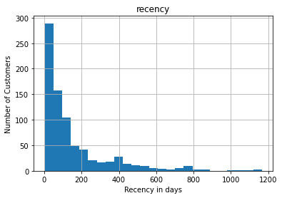
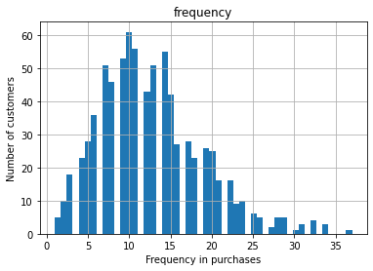
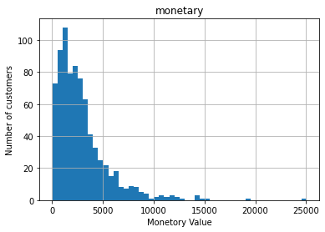
Results
We have performed multiple calculations to retrieve RFM Scores by using Customer Details, Order Date, and Sales features.
We segmented the data into six groups based on RFM scores: At risk, Can't loose, Needs attention, Loyal customers, Champions, and New customers.

Slide 10
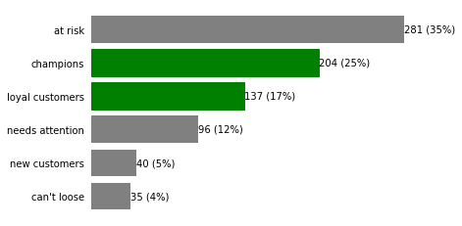
The bar chart illustrates that 35 percent of customers are at risk who purchased often but long ago, followed by 25 percent of champions who are heavy spenders.
There are 17% of loyal customers that purchase regularly. Five percent of customers are new customers, and 12 percent are customers who need attention.

Slide 11
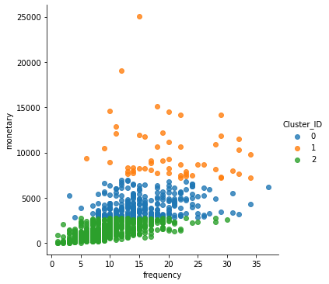

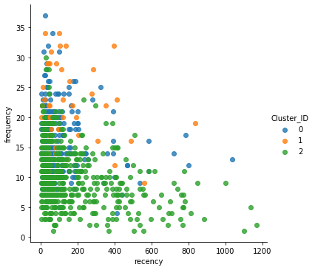
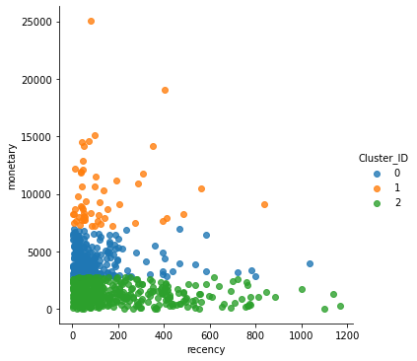
Interpretation
Cluster 0: Silver Customer
Cluster 2: Bronze Customer
Cluster 3: Gold Customer

Slide 12
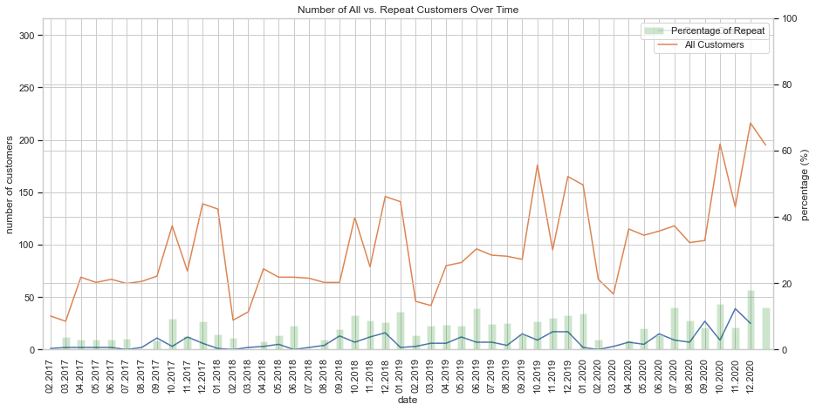
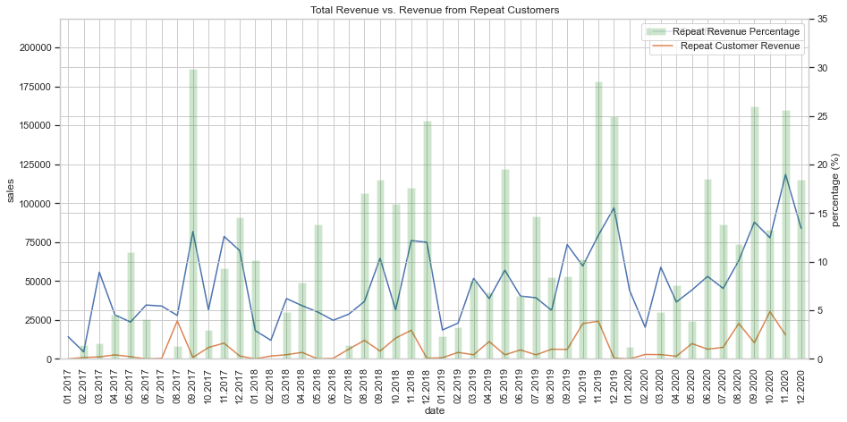




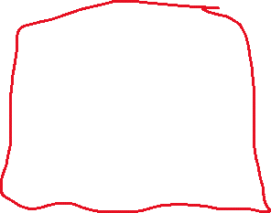
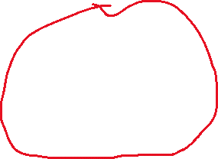
We can see similar patterns in both of the charts and it shows that number of sales increases from Feb 2017 till Nov 2017 and same pattern follows for 2018,2019 and 2020. We believe that same pattern will follow in 2021 also.

Slide 13
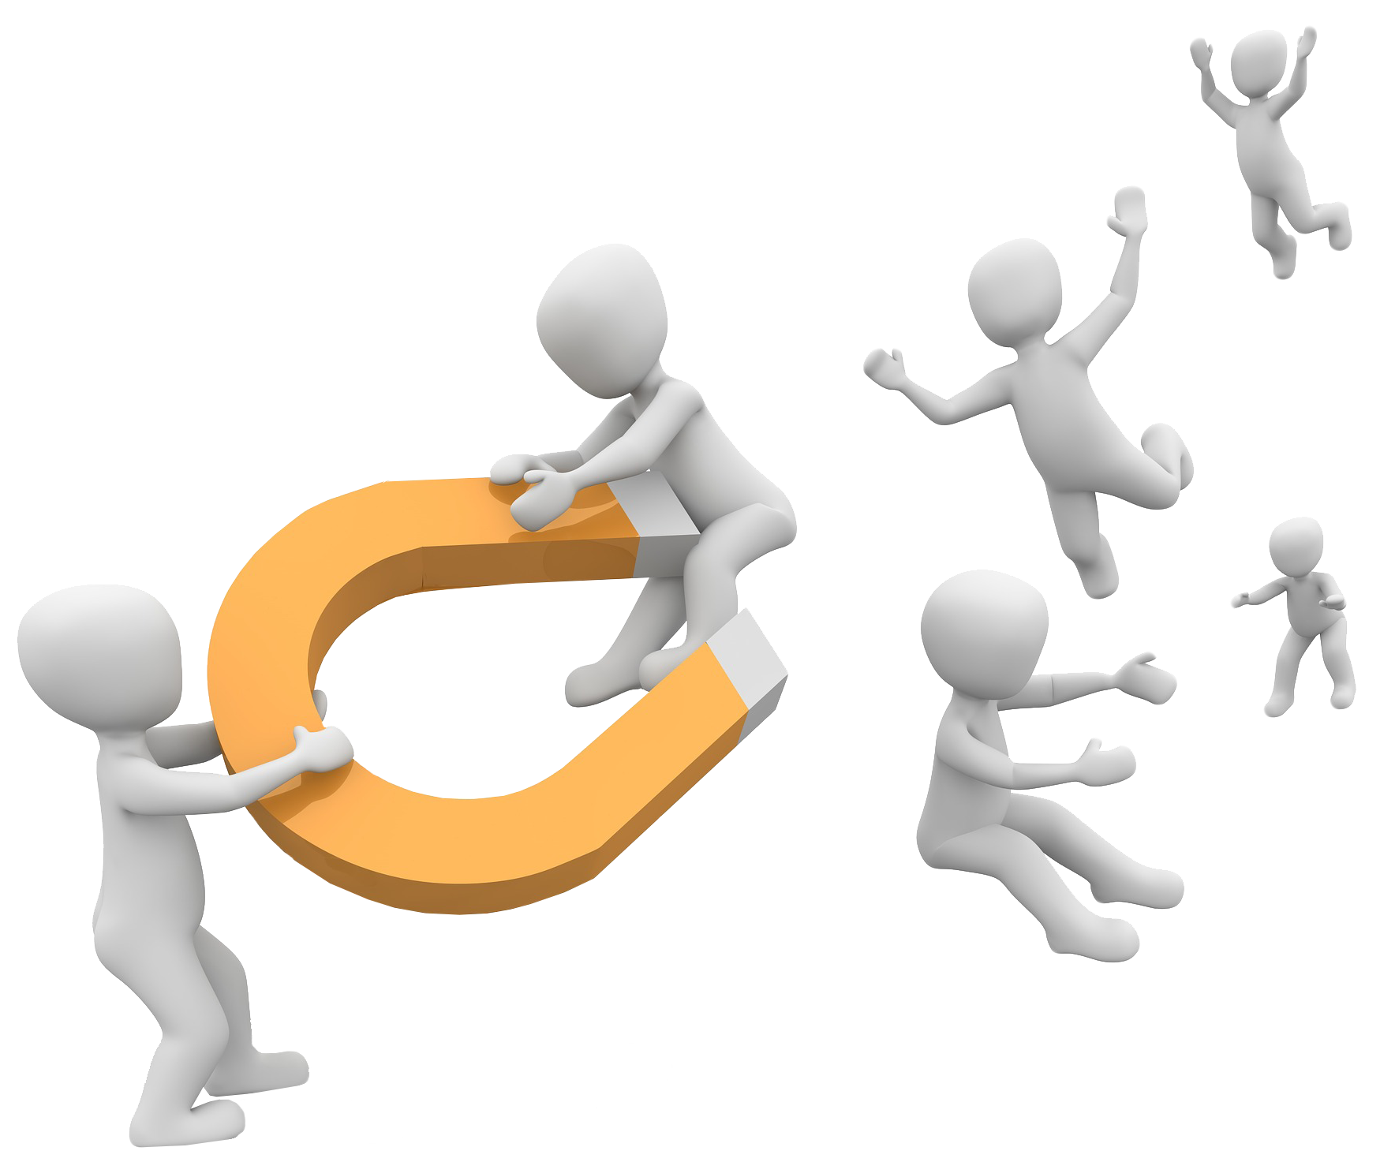


Future Recommendations
Attract Customers
Personalized Profiles
Seasonal fluctuation
Based on Customers Segmentation give discounts or coupons to customers based on their segment. For example: For customers falling in categories of “Can’t Lose”, “Loyal” and Champions , we can give them early access to sales. For customers who are most likely to churn, we can put sale on their items of interest and send them personalised alerts.
We can conduct a thorough study of each of the customer and create individual profile, where we will observe their shopping patterns based on time and items purchased . Using this info we can send them reminders or alerts when the items of their interest are on sale or according to the pattern are needed to be bought again.
Seasonality plays an important role in business. Similar patterns could be seen in sales and number of customer so we can study sales of that time period and improve our strategies accordingly. During peak seasons, demand tends to be high.
This Photo by Unknown Author is licensed under CC BY-NC

Slide 14
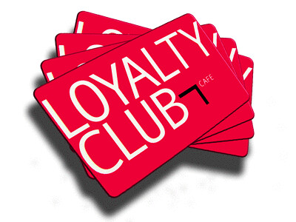


Loyalty Cards
Advertising Strategy
Special Day Offers
Everyone wants to feel special on their birthday and anniversary. So, we can give different kinds of offers to customers based on the occasion.
For Example: We can give 20% discount to the customers in their birthday month. Or buy one get one free on the occasion of their anniversary.
Based on Customers Segmentation we can create loyalty cards scheme in which they can gain points each time of purchasing and these points could transfer into a discount.
Some cities have fewer sales, lack of awareness can be the reason for this, hence advertising in those cities might help in more sales. Advertisement can be done through newspaper, radio, Billboard etc.
This Photo by Unknown Author is licensed under CC BY-NC-ND
This Photo by Unknown Author is licensed under CC BY-NC-ND
This Photo by Unknown Author is licensed under CC BY

Slide 15
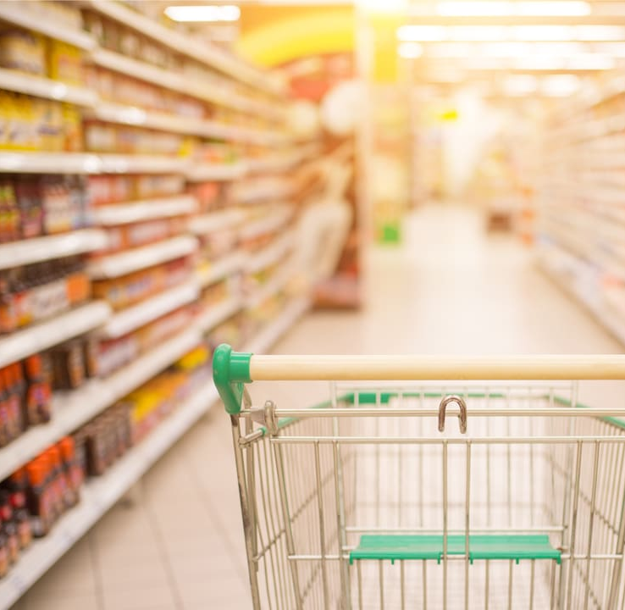
Thank you
This Photo by Unknown Author is licensed under CC BY-SA-NC

